Slide 1










Hosting Strategies
Renato Matos & Damasio Sabino
2023/08

Slide 2
Abstract
This session will provide an overview of how the AWS services: Amazon S3, CloudFront, Amplify, EC2, Route53, BeansTalk, ECS, and EKS can easily help us to deploy on AWS our web solution.
During this demo we’ll be able to identify which AWS resource best fit with our app, and for that, we’ve provided two different web solutions: one built using Vue.js (pure JavaScript Framework) and the second one using .NET Framework with Blazor.

Slide 3



Agenda
Introduction (10 minutes)
Why so many strategies and how to identify which one best fit with my app
Overview about the AWS resources
Demo (10 minutes)
Deploying our Vue.js web app
Deploying our .NET web app
AWS Costs (5 minutes)
Playing with AWS Free Tier and Cost Explorer
Reducing AWS Costs
Conclusion (5 minutes)
Quiz (How would you answer?)

Slide 4


Resources
In order to help you to reproduce the playground, we have shared a nice github repository and some Youtube videos which contains:
The source code used on Vue.js and .NET Blazor applications
Well detailed tutorials to guide you how to:
Getting a Free Domain amen.pt
Provision and manage SSL/TLS certificates with AWS Certificate Manager
Routing you web traffic with Route 53
Step by step with S3 Bucket, CloudFront and Amplify
Lunching an EC2 Linux Instance and deploying our docker application
Let’s config our ECS and EKS Cluster
Easy deploy using Elastic Beanstalk

Slide 5
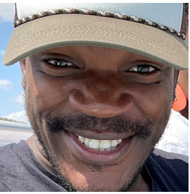
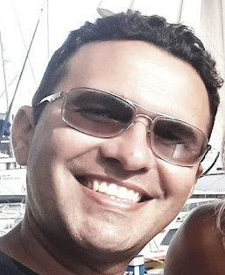
Speakers
Damásio has been working as a consultant in different industries such as Oil and Gas, Telcom and Finance. His main framework is .NET (framework and Core), mostly backend oriented but open to frontend. He is interested in Agile, Cloud, DevOps practices and thinking, as well as the many ways of knowledge sharing. Outside of work he spends time with his family, friends and doing Brazilian Jiu-jitsu and/or Muay Thai.
Renato is a full stack developer focusing on .NET backend. During his free time, Renato enjoys watching Netflix series', reading books, and spending quality time playing with his dogs and his lovely child.

